Slide 1


Team 1: ADC Resolution vs. Sensorless Motor Control Performance
Bi-Weekly Update 5 Cristian Ornelas, Tyler Hawkins, Tamara Basfar, John King Sponsor: Kevin Allen (Texas Instruments) TA: Fahrettin Ay
Notes:
Michelle

Slide 2
Project Summary
Problem: How do different configurations of sensorless motor control affect performance?
Solution: Port the universal motor control software to one of TI’s newest c2000 devices. Develop updated configurations of the universal solution, and test the effects on sensorless control performance.
Notes:
Kyle

Slide 3
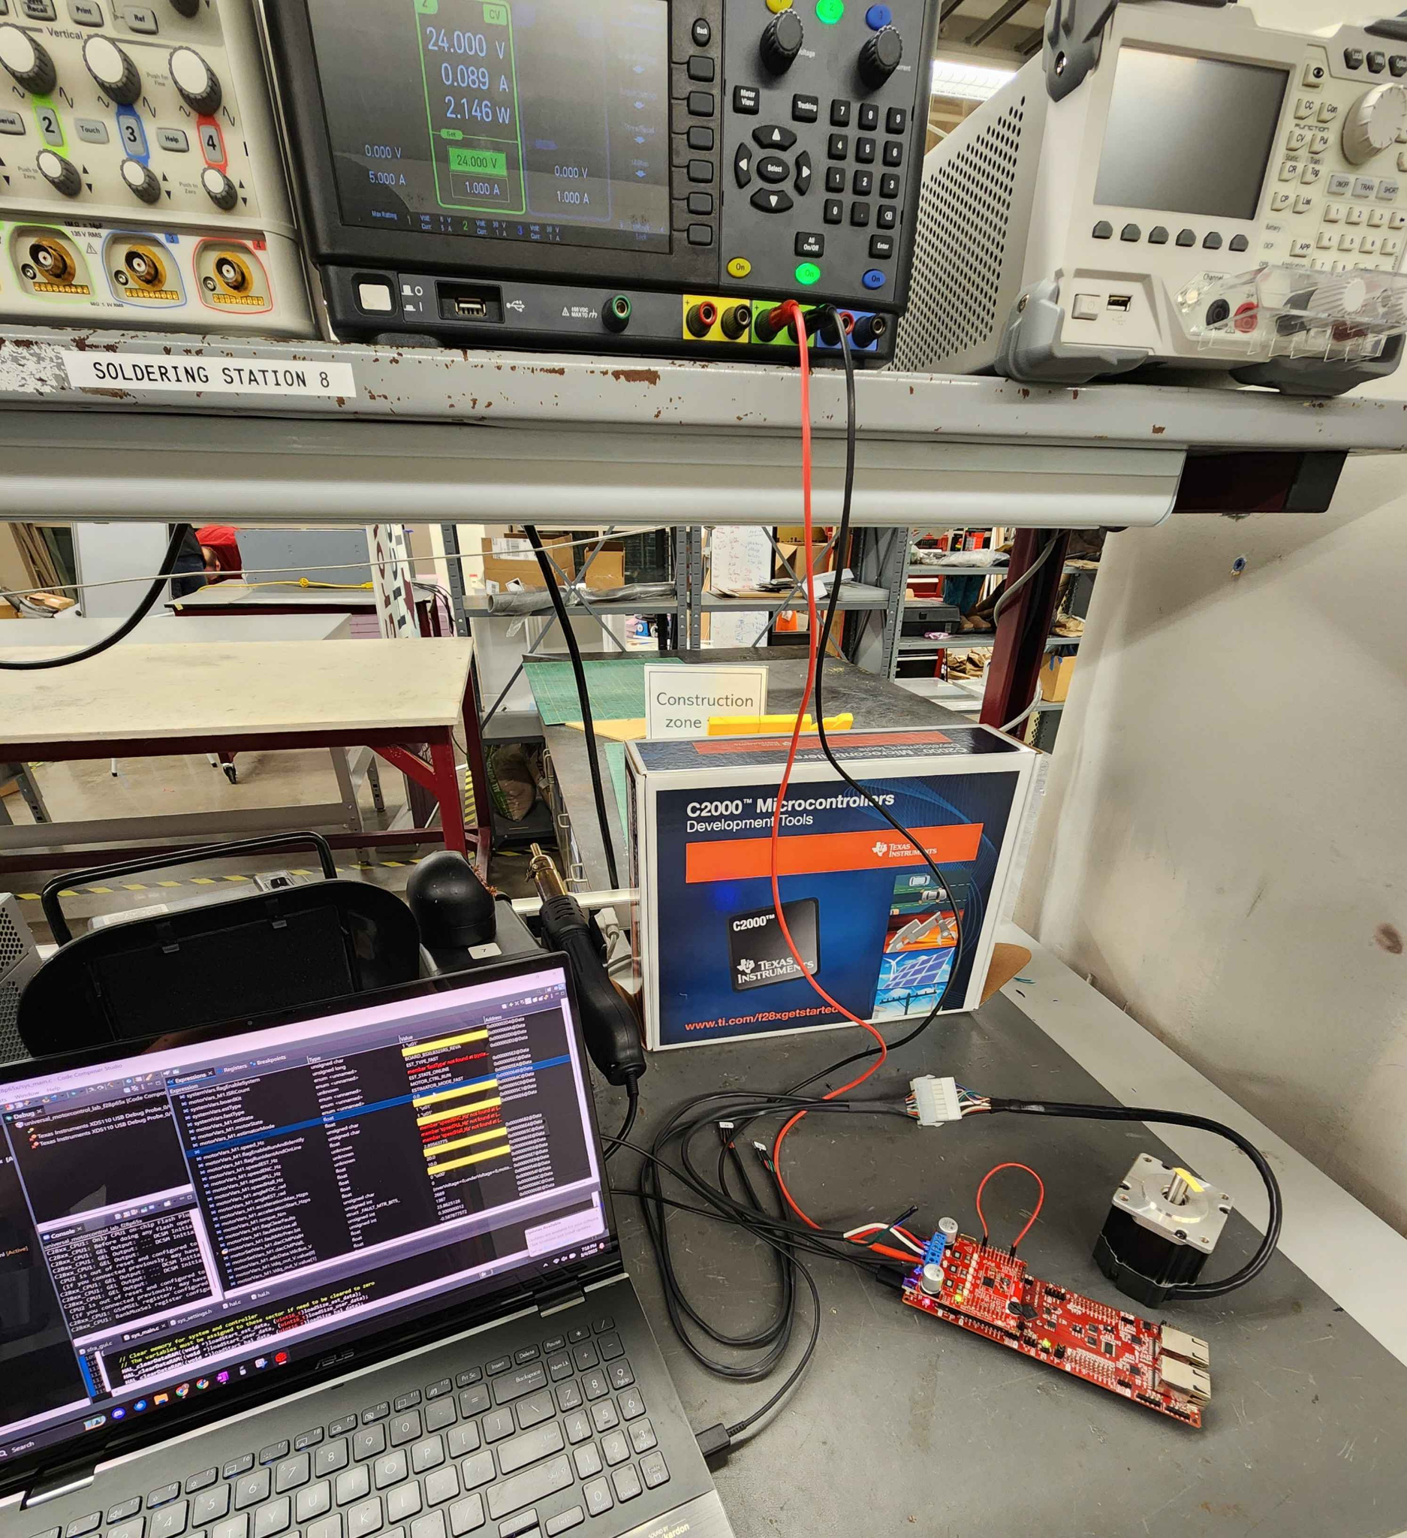
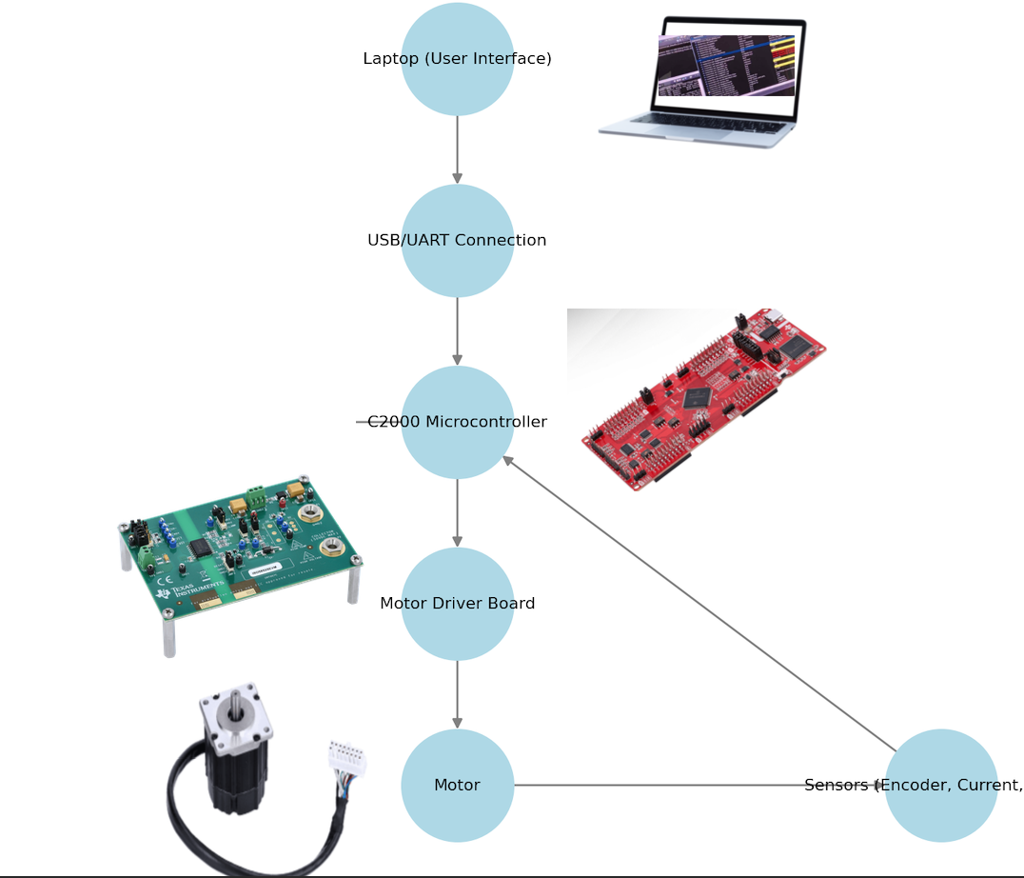
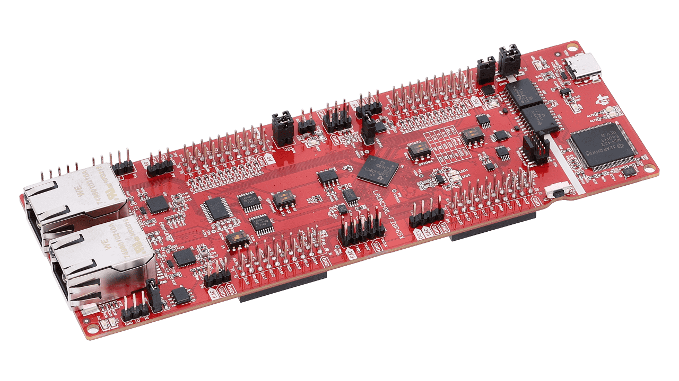
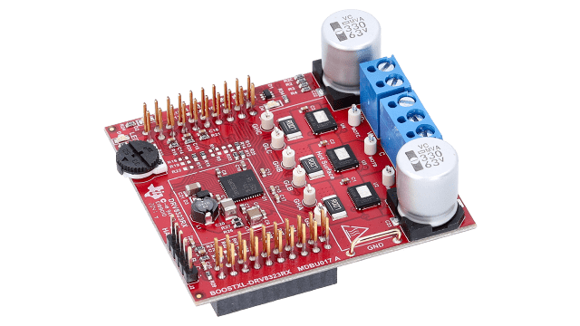
Integrated System Diagram
Notes:
Eric

Slide 4
Project Timeline
Port motor control solution to F28P65x Board [full system integration] (completed 1/30) | Modify software to enable data capture (to complete by 2/20) | Modify software for ADC resolution (12/16) bit (to complete by 3/6) | Modify software to run using 32/64 bit floating point (to complete by 3/6) | Modify software to enable oversampling (to complete by 3/6) | Test full software compatibility & Validation (to complete by 3/24) | Full system testing (to complete by 4/10) | Demo and Report (to complete by 4/21)
Notes:
Eric

Slide 5
Team Progress
Accomplishments since last update 20 hrs of effort (each) | Ongoing progress/problems and plans until the next presentation
-Resolved final errors with Data Collection -Successfully integrated 12/16 bit ADC into the Float-32 & Float-64 solutions -Successfully integrated oversampling into the Float-32 & Float-64 solutions -Completed System Validation and began testing | -Collect and analyze data of different control configurations. -Test effects of performance with different loads on motor using a hysteresis brake -Finish System testing & gather findings

Slide 6
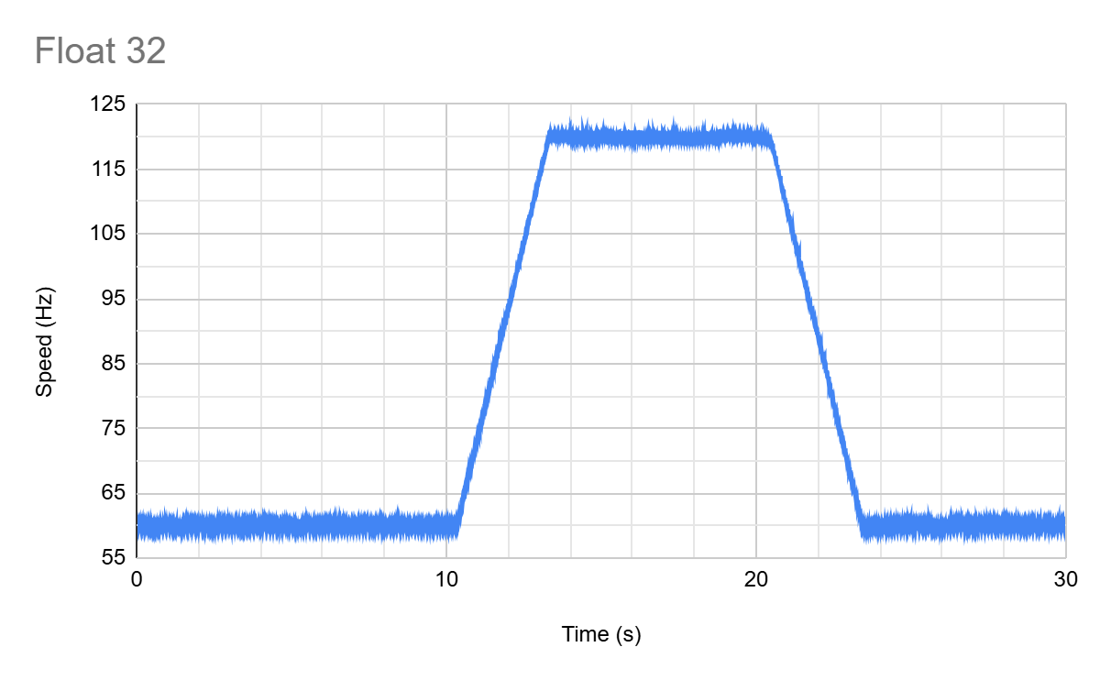

Slide 7
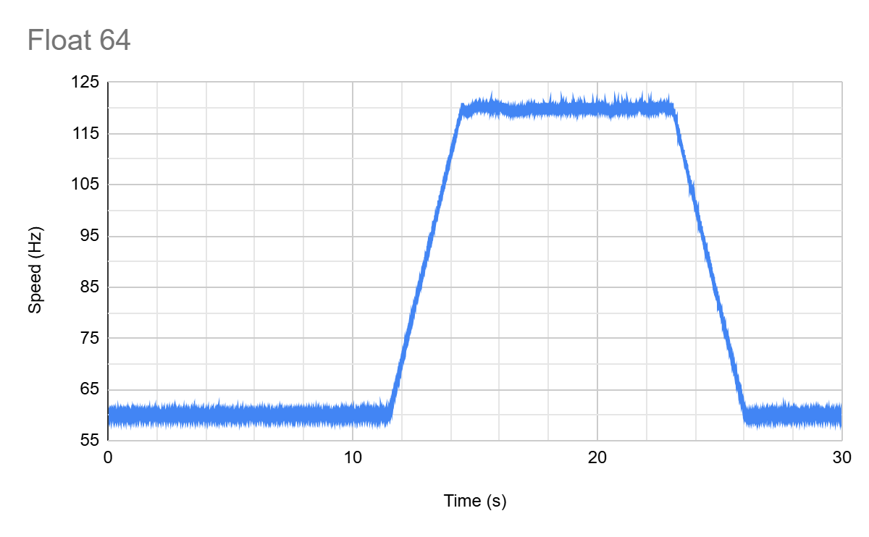

Slide 8
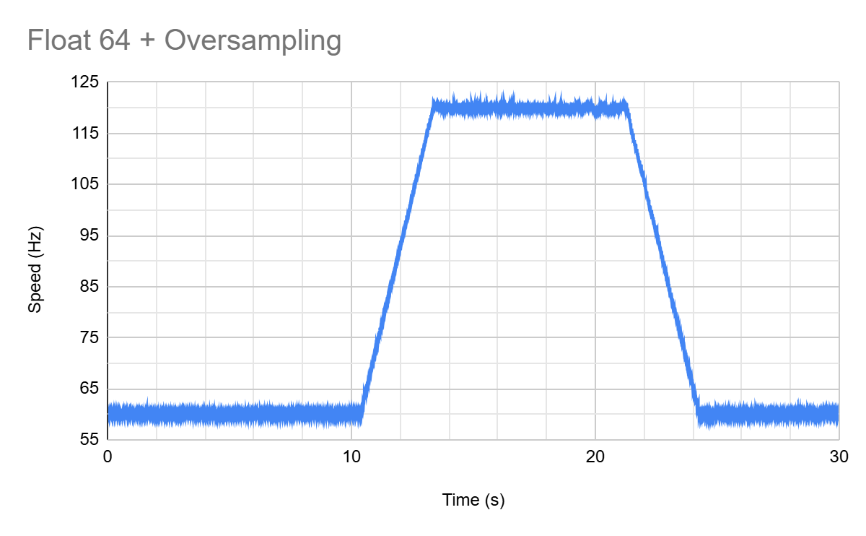

Slide 9
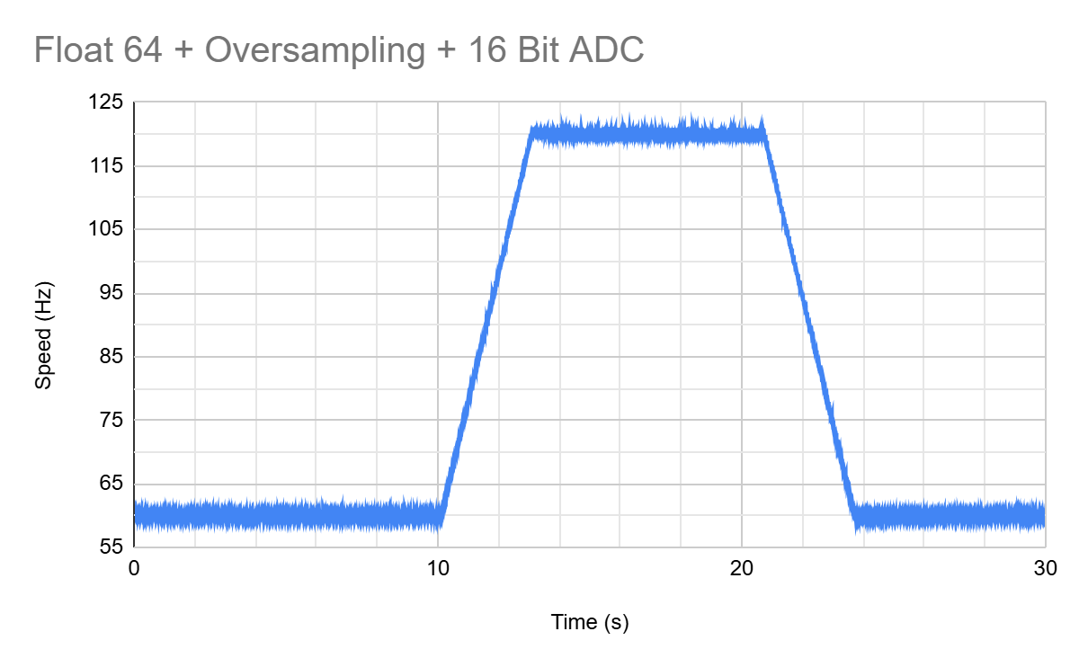

Slide 10
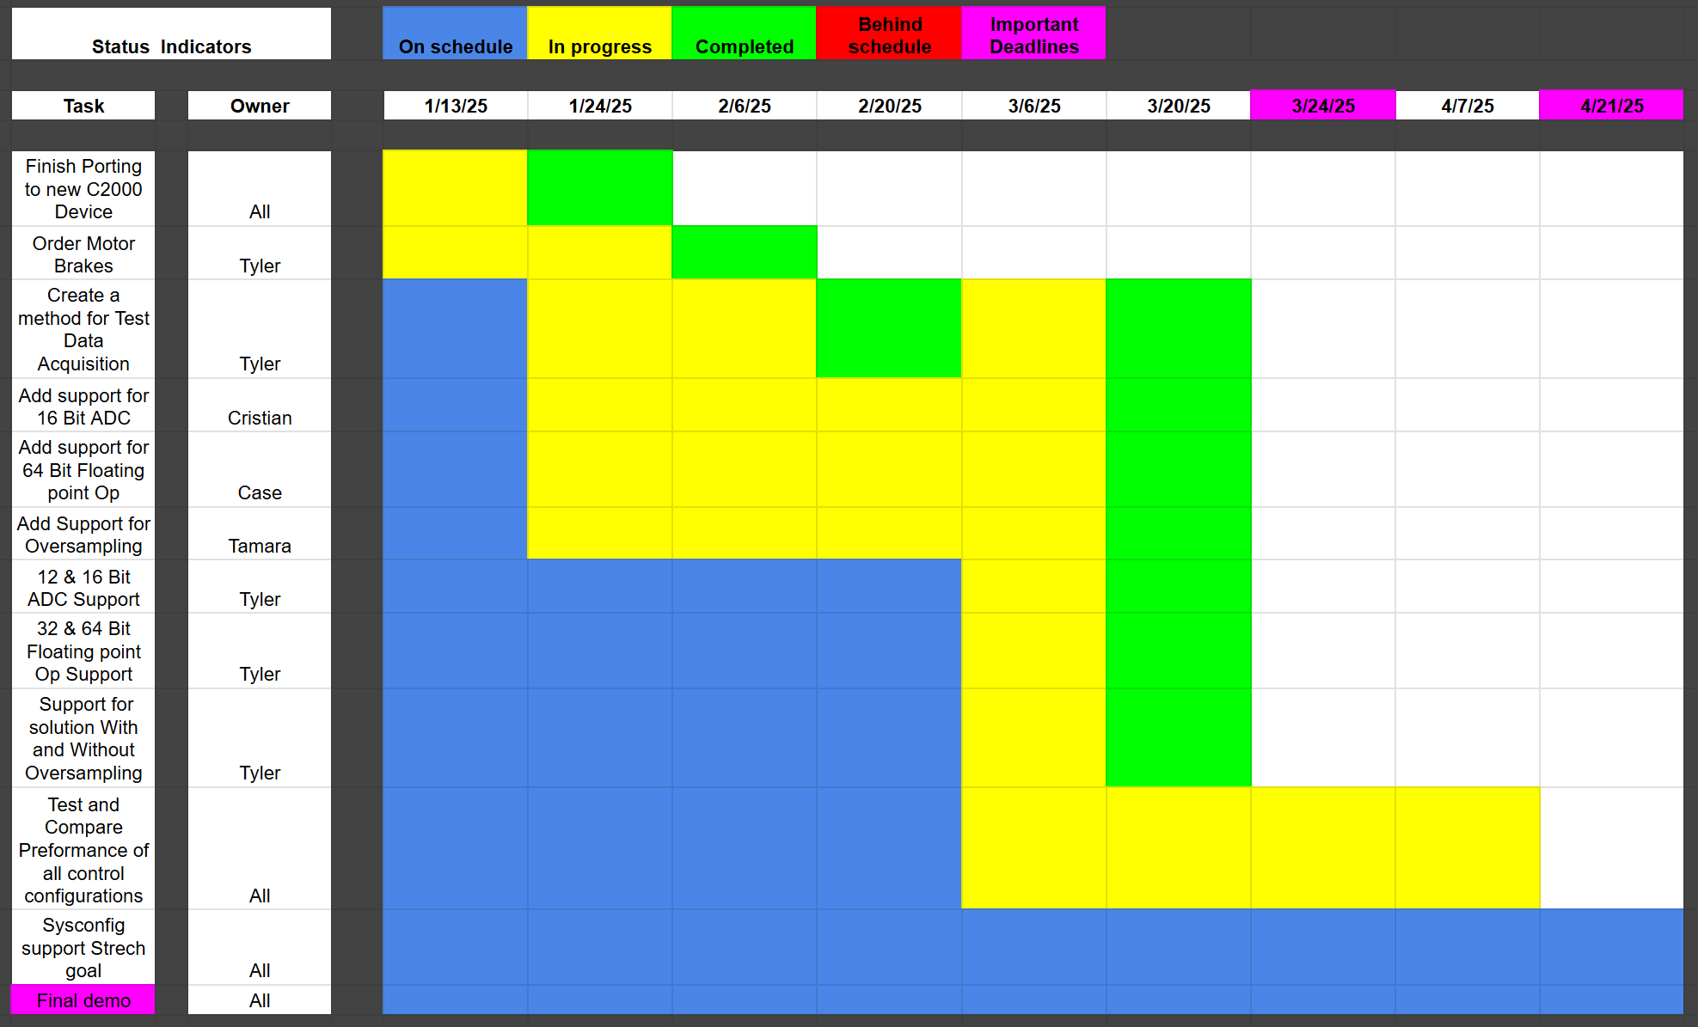
Execution Plan
Notes:
Michelle

Slide 11
Validation Plan
Task | Specification | Result | Owner
Porting Solution onto F28p65x board (requirement #1) | Ported motor control software onto f28p65x board successfully according to the Universal Motor control guide | PASSED | All
16 Bit ADC resolution (requirement #2) | The system correctly operates using 16-bit ADC resolution according to The Universal Motor control guide | PASSED | Cristian
64-bit Floating point operation (requirement #4) | The system Correctly Operates using 64-bit Floating Point according to The Universal Motor control guide | PASSED | Case
Enable oversampling (requirement #3) | The system Correctly Operates while oversampling is enabled according to The Universal Motor control guide | PASSED | Tamara
12 Bit & 16 Bit ADC resolution Support (requirement #2) | The system correctly operates using either 12-bit or 16-bit ADC resolutions according to The Universal Motor control guide | PASSED | Cristian

Slide 12
Validation Plan
Task | Specification | Result | Owner
32-bit & 64-bit Floating point operation (requirement #4) | The system Correctly Operates using either 32-bit or 64-bit Floating Point according to The Universal Motor control guide | PASSED | Tyler
Test data acquisition (requirement #5) | The system Correctly gathers test data for the following parameters: speed ripple, speed step, and load step. Able to be graphed and differences should be able to be seen. | PASSED | Tyler
Test 12 vs 16 Bit performance (requirement #5) | Test the performance of 12-bit and 16-bit ADC resolutions: speed ripple, speed step, load step. | TESTING | Cristian
Test 32-bit & 64-bit Floating-point performance (requirement #5) | Test the performance of 32-bit and 64-bit ADC Floating point operations: speed ripple, speed step, load step. | TESTING | Case
Test the performance of oversampling (requirement #5) | Test the effectiveness of oversampling: speed ripple, speed step, load step. | TESTING | Tamara

Slide 13
Thanks & Gig’em
Team 1: ADC Resolution vs. Sensorless Motor Control Performance

